Slide 1

Citing Letters and Memoranda

Slide 2

Rule 32.1: Components for Full Citation
Designation
Author’s name,
Author’s Title and Affiliation,
to
Recipient’s name,
Recipient’s Title and Affiliation,
Subject
Pinpoint reference
(Date)
(Location information).

Slide 3

Rules 32.1(a), (b), (d): Designation, Author, and Recipient
Start with “Ltr, from” or “Memo. from”
Author’s Name
  Include the full name of the author.
  Follow Rule 22.1(a).
Do the same for the recipient(s).

Slide 4

Rules 32.1(c), (e): Author’s and Recipient’s Titles and Affiliations
Follow Rule 31.1(c) on interviews.
  Present titles in ordinary type.
  Abbreviate per Appendix 3.
  If is no title or affiliation, provide a brief job description.
  Capitalize words per Rule 3.

Slide 5

Rule 32.1(f): Subject
Provide the title of the document.
  For example, in a memorandum, copy what appears on the “re” or “subject” line.
If the document does not contain a title, concisely describe the subject matter.
Italicize the subject.

Slide 6
Rules 32.1(g), (h): Pinpoints and Date
Pinpoint Reference: Include the page on which the cited material appears – even if the author did not include page numbers.
Date: Follow Rule 31.1(d) for interviews.
  Provide the exact date (month-day-year).
  Abbreviate the month per Appendix 3.
  Enclose the date in parentheses.

Slide 7

Rule 32.1(i): Location
In a separate parenthetical, describe where readers might obtain a copy.
Typically, we use (copy on file with Author) or (copy on file with Stetson Law Review).

Slide 8
Rule 32.2: Short Citations
Use id. when id. is appropriate.
Otherwise:
  Designation, supra n. ___, at pinpoint.
  Letter, supra n. 3, at 1.
  Memo., supra n. 65, at 3-5.
  If there are two letters or two memos in a single footnote, add the author’s last name:
    Johnson Ltr., supra n. 7, at 1.

Slide 9
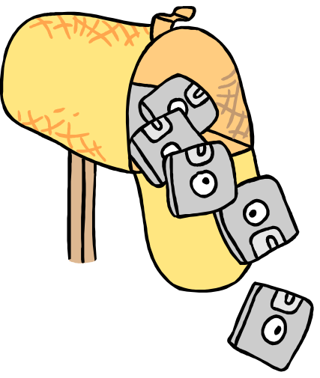
Citing Electronic Mail

Slide 10

Rule 41.1: Full Citation for Personal E-mail.
Analogize to Rule 32 for letters and memos, but use “E-mail” as the designation.
  Also, you typically will not have a pinpoint.
E-mail from Gina F. Crowder, Pres., Am. Gems, Inc., to Forest P. Jenkins, Pres., Gemstones, Ltd., Price Increases (Feb. 12, 2006) (copy on file with Author).

Slide 11

Rule 41.2: Full Citation for Discussion Group or Listserv E-mails
Use the list or group’s name (or address, if a name is not available) in place of the recipient’s name, title, and affiliation.
E-mail from Edward Yu, Pres., Legalcorps, Inc., to LAW listserv, Update on New Rule Changes (Feb. 8, 2005) (copy on file with the Stetson Law Review).

Slide 12

Rule 41.3: Short Citations
Use id. when possible.
Otherwise:
  E-mail, supra n. 108.
Same format as for letters and memos.

Slide 13
Final Questions?

